Slide 1
Lab 4: Multivariate Kalman filter
Learning objectives:
Skill to develop multivariate time-series model
Use simulation to evaluate model fit
Visualize uncertainty during forecast period

Slide 2
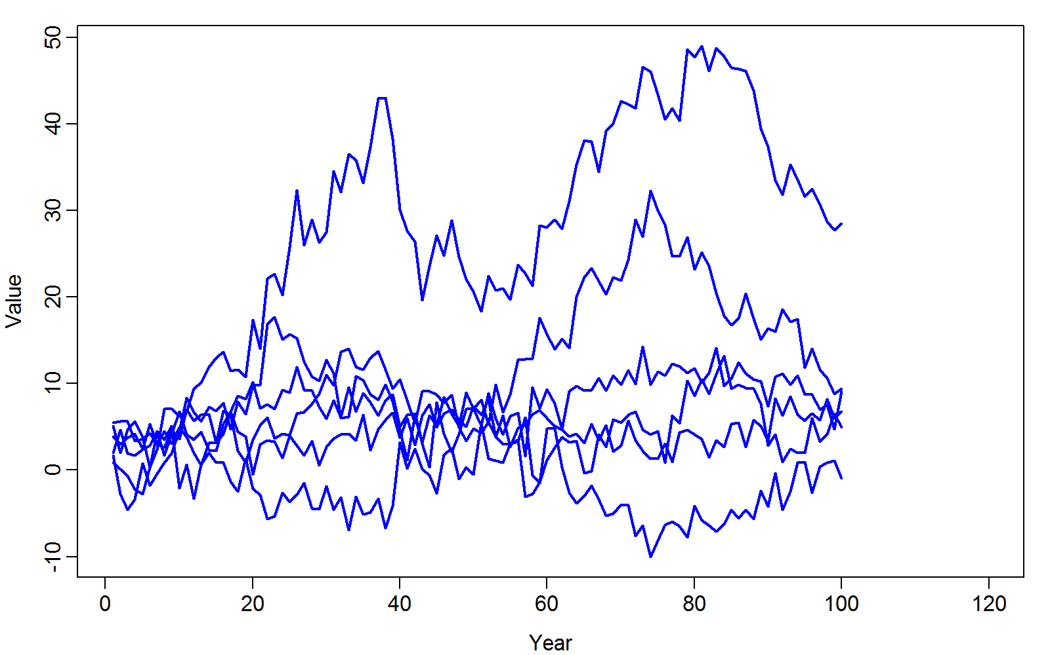
Given timeseries from multiple populations…

Slide 3
Given timeseries from multiple populations…
How do we estimate parameters in data-generating process?
How do we forecast future values?

Slide 4
Given timeseries from multiple populations…
Steps
Hypothesize data-generating process
Estimate parameters using maximum likelihood
Propagate uncertainty using delta method
Evaluate model fit and repeat steps #1-3

Slide 5

Given timeseries from multiple populations…
Steps
Hypothesize data-generating process
$$x_{t+1}\sim MVN(x_{t},Σ_{x})$$
$$y_{t,p}\sim Normal(x_{t,p},σ_{M}^{2})$$
$$\text{Where}$$
$$Σ_{x}=LL^{T}$$

Slide 6
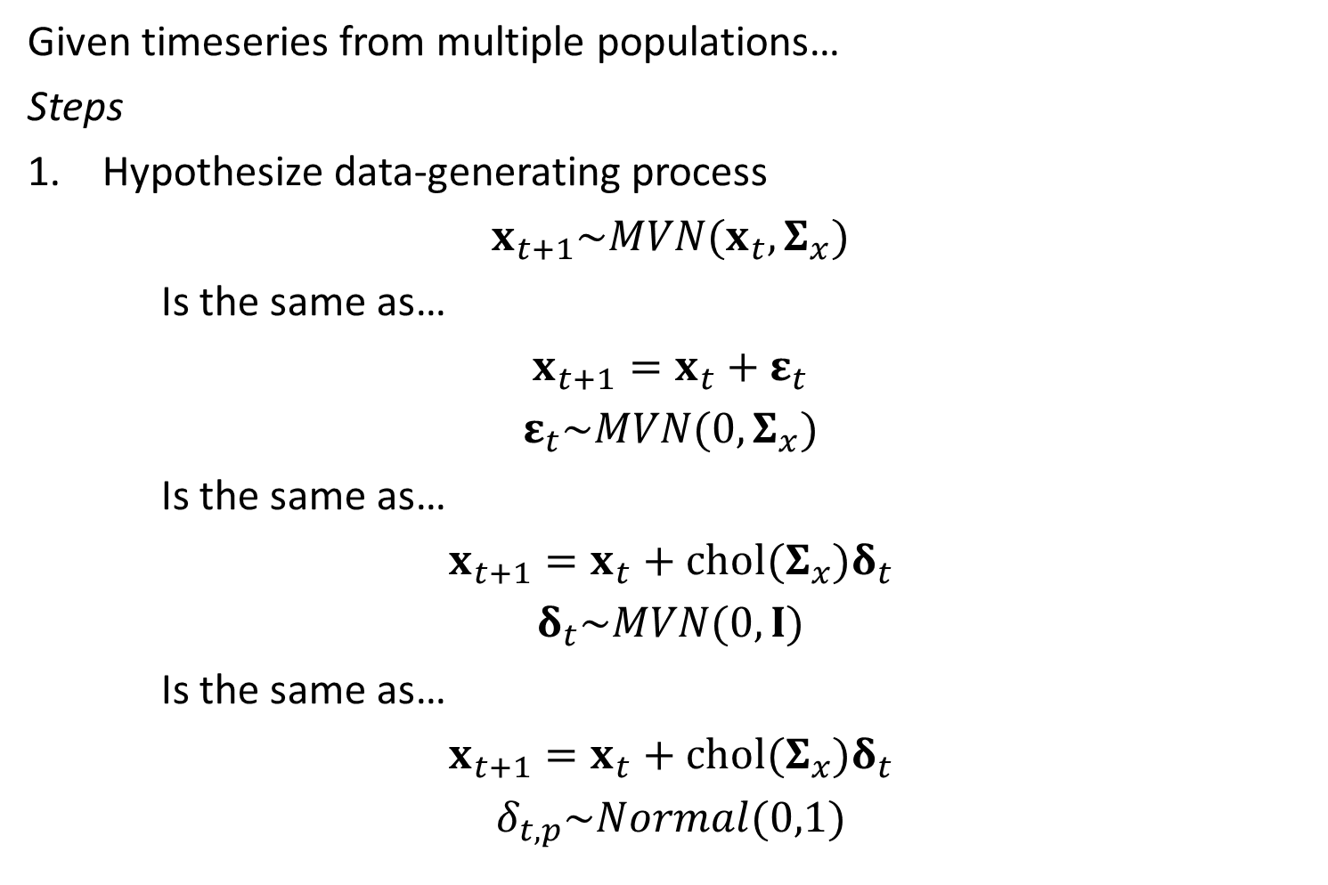
Given timeseries from multiple populations…
Steps
Hypothesize data-generating process
$$x_{t+1}\sim MVN(x_{t},Σ_{x})$$
Is the same as…
$$x_{t+1}=x_{t}+ε_{t}$$
$$ε_{t}\sim MVN(0,Σ_{x})$$
Is the same as…
$$x_{t+1}=x_{t}+chol(Σ_{x})δ_{t}$$
$$δ_{t}\sim MVN(0,I)$$
Is the same as…
$$x_{t+1}=x_{t}+chol(Σ_{x})δ_{t}$$
$$δ_{t,p}\sim Normal(0,1)$$

Slide 7
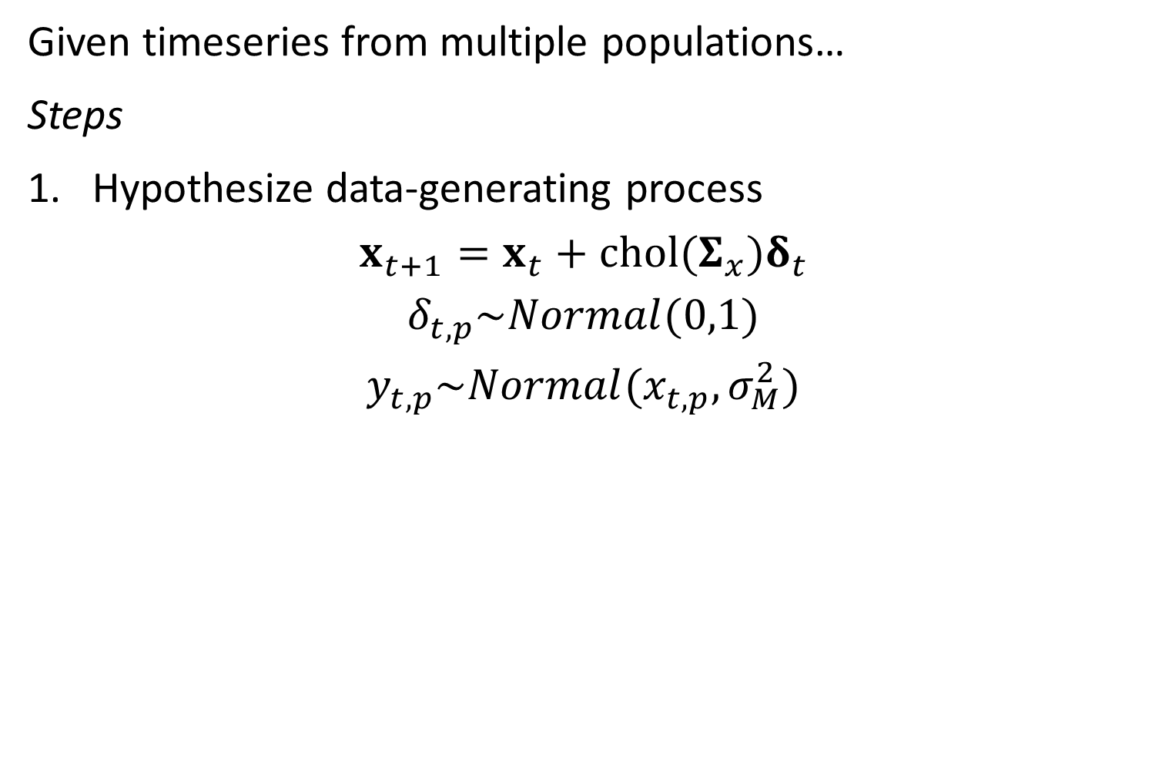
Given timeseries from multiple populations…
Steps
Hypothesize data-generating process
$$x_{t+1}=x_{t}+chol(Σ_{x})δ_{t}$$
$$δ_{t,p}\sim Normal(0,1)$$
$$y_{t,p}\sim Normal(x_{t,p},σ_{M}^{2})$$

Slide 8
[look at code]

Slide 9
Given timeseries from multiple populations…
Steps
2. Estimate parameters using maximum likelihood
Param | Starting value | Lower | MLE | Upper | Final gradient
log_VarM | 0 | -Inf | 0.404701 | Inf | 3.22E-08
x0_p | 0 | -Inf | 3.423018 | Inf | -2.20E-08
x0_p | 0 | -Inf | 3.249082 | Inf | 1.57E-08
x0_p | 0 | -Inf | -0.61913 | Inf | -1.12E-08
x0_p | 0 | -Inf | 2.932184 | Inf | 2.72E-09
x0_p | 0 | -Inf | 1.07471 | Inf | 5.29E-09
x0_p | 0 | -Inf | 4.304056 | Inf | -1.24E-08
Lp | 2.134858 | -Inf | 0.384887 | Inf | -6.04E-08
Lp | -0.75926 | -Inf | -0.30681 | Inf | 4.43E-08
Lp | 0.250707 | -Inf | -1.21852 | Inf | -3.07E-08
Lp | 1.459138 | -Inf | 0.656695 | Inf | 1.03E-08
Lp | 1.041312 | -Inf | -0.75322 | Inf | 1.48E-08
Lp | 1.630788 | -Inf | -0.15517 | Inf | -3.28E-08
Lp | 0.047519 | -Inf | 0.460655 | Inf | 2.84E-07
Param | Starting value | Lower | MLE | Upper | Final gradient
Lp | -0.54774 | -Inf | 1.334437 | Inf | -1.62E-07
Lp | -0.67224 | -Inf | -0.49813 | Inf | 5.75E-08
Lp | -0.31427 | -Inf | 1.787124 | Inf | 8.35E-08
Lp | 0.185839 | -Inf | -0.07834 | Inf | -1.99E-07
Lp | 1.048228 | -Inf | 0.812711 | Inf | 4.48E-09
Lp | -0.08609 | -Inf | 0.315512 | Inf | -1.30E-09
Lp | -1.28034 | -Inf | -0.95924 | Inf | -8.74E-09
Lp | 2.15703 | -Inf | -1.07585 | Inf | 6.54E-09
Lp | 0.122517 | -Inf | -0.11135 | Inf | -3.72E-08
Lp | 1.314569 | -Inf | 1.541856 | Inf | 3.65E-08
Lp | 1.243474 | -Inf | 0.603224 | Inf | -4.91E-08
Lp | 0.403457 | -Inf | -3.64E-09 | Inf | 1.13E-06
Lp | 3.002462 | -Inf | -6.72E-09 | Inf | -3.33E-06
Lp | 0.966776 | -Inf | -1.24E-12 | Inf | -7.53E-10

Slide 10
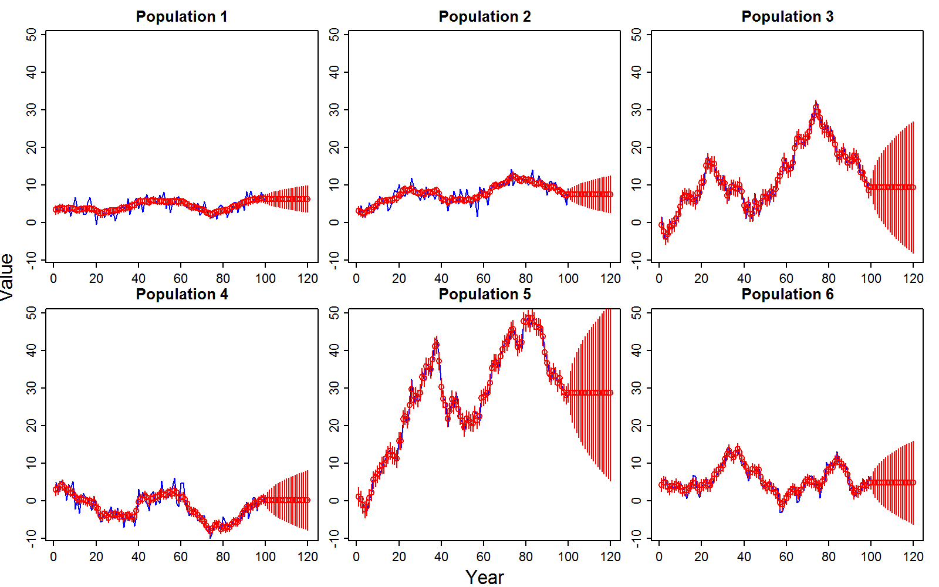
Given timeseries from multiple populations…
Steps
3. Propagate uncertainty using delta method

Slide 11
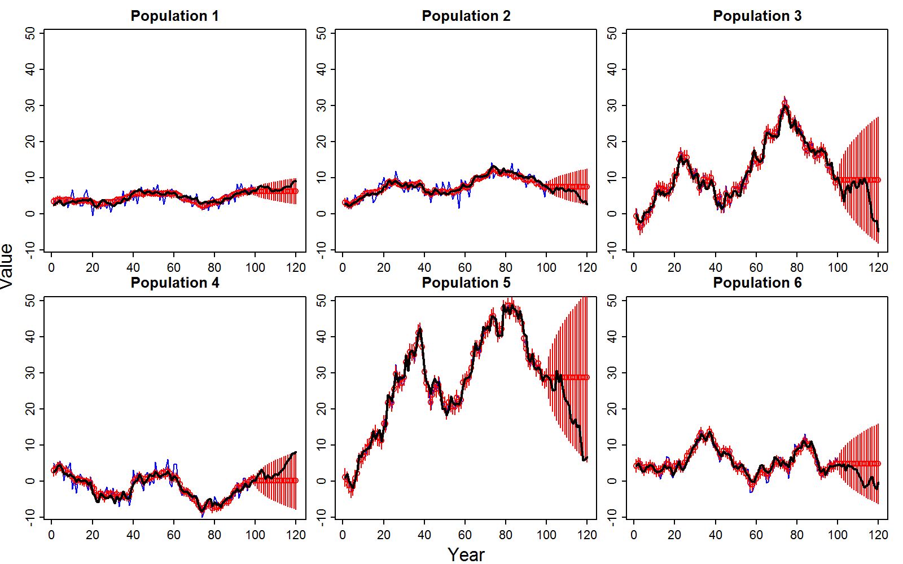
Given timeseries from multiple populations…
Steps
3. Propagate uncertainty using delta method

Slide 12
Given timeseries from multiple populations…
Steps
3. Propagate uncertainty using delta method

Slide 13
Given timeseries from multiple populations…
Steps
4. Evaluate model fit and repeat steps #1-3
Methods to evaluate fit
Inspect residuals
Compare data and its predictive distribution given parameters
Conduct a simulation experiment

Slide 14
Given timeseries from multiple populations…
Steps
4. Evaluate model fit and repeat steps #1-3
Simulation experiment
Simulate random effects given fixed effects
Simulate data given fixed and random effects
Re-fit model
Compare MLE from re-fits to original fits
Replicated estimates should be centered on original fits

Slide 15
[look at code]

Slide 16
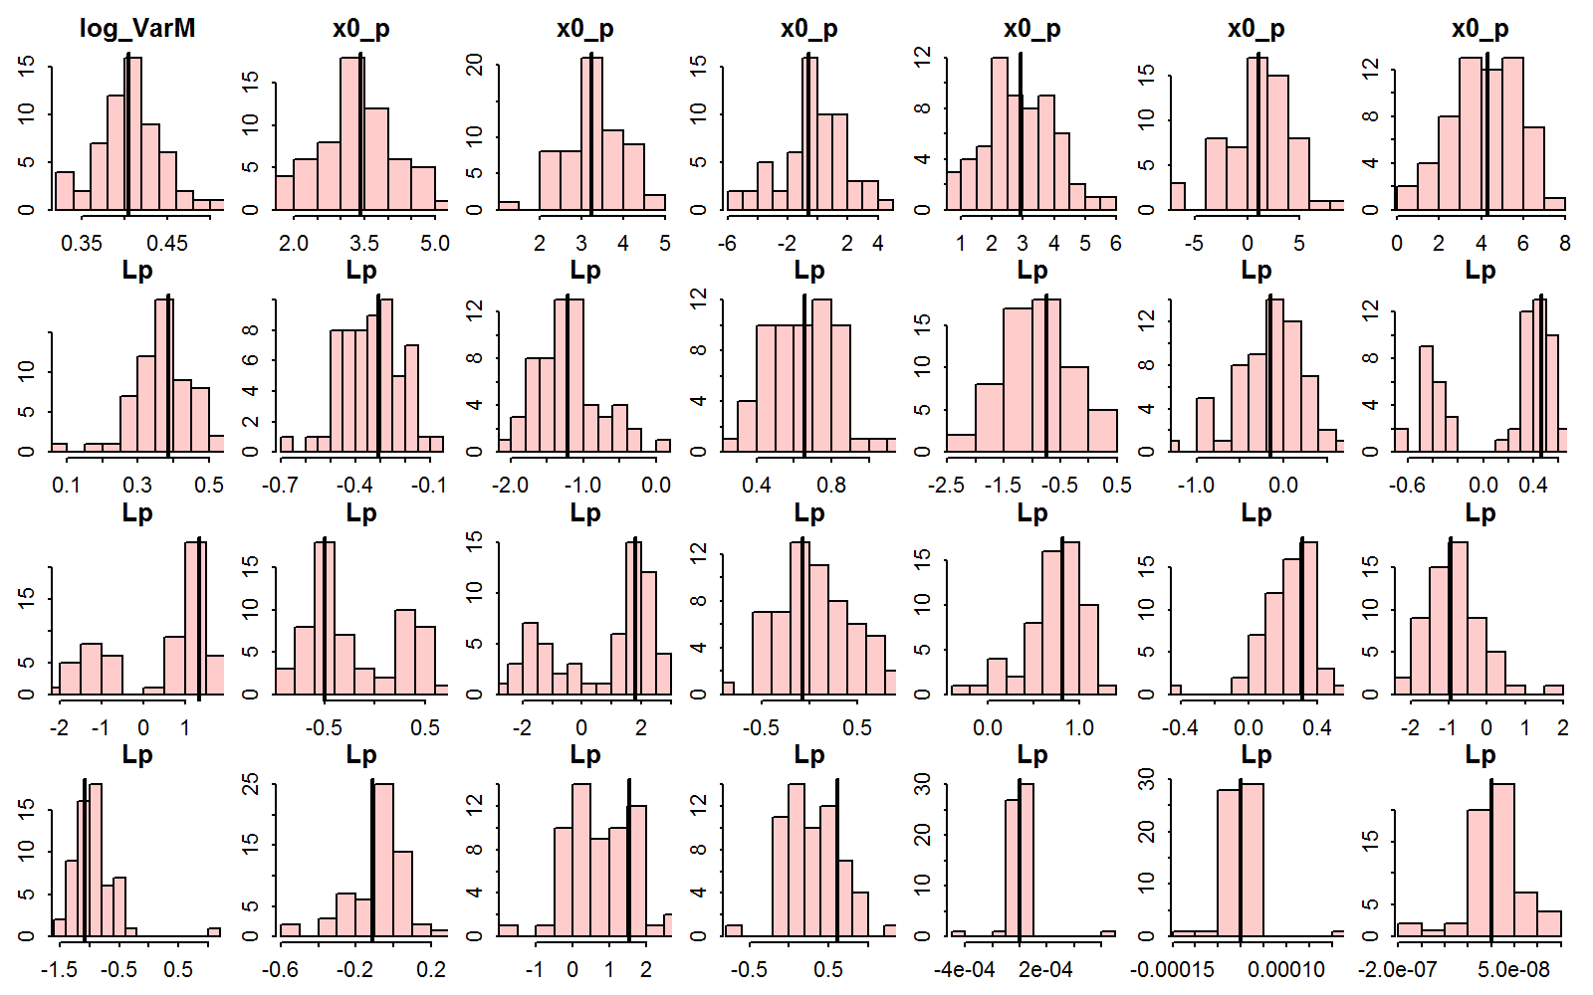
Given timeseries from multiple populations…
Steps
4. Evaluate model fit and repeat steps #1-3

Slide 17
Summary
Can hindcast and forecast abundance with useful uncertainty intervals
Can assess model fit using simulation
A Kalman filter forecasts future abundance equal to last estimated state
Strong benefit to using biological information to inform state-transitions

Slide 18
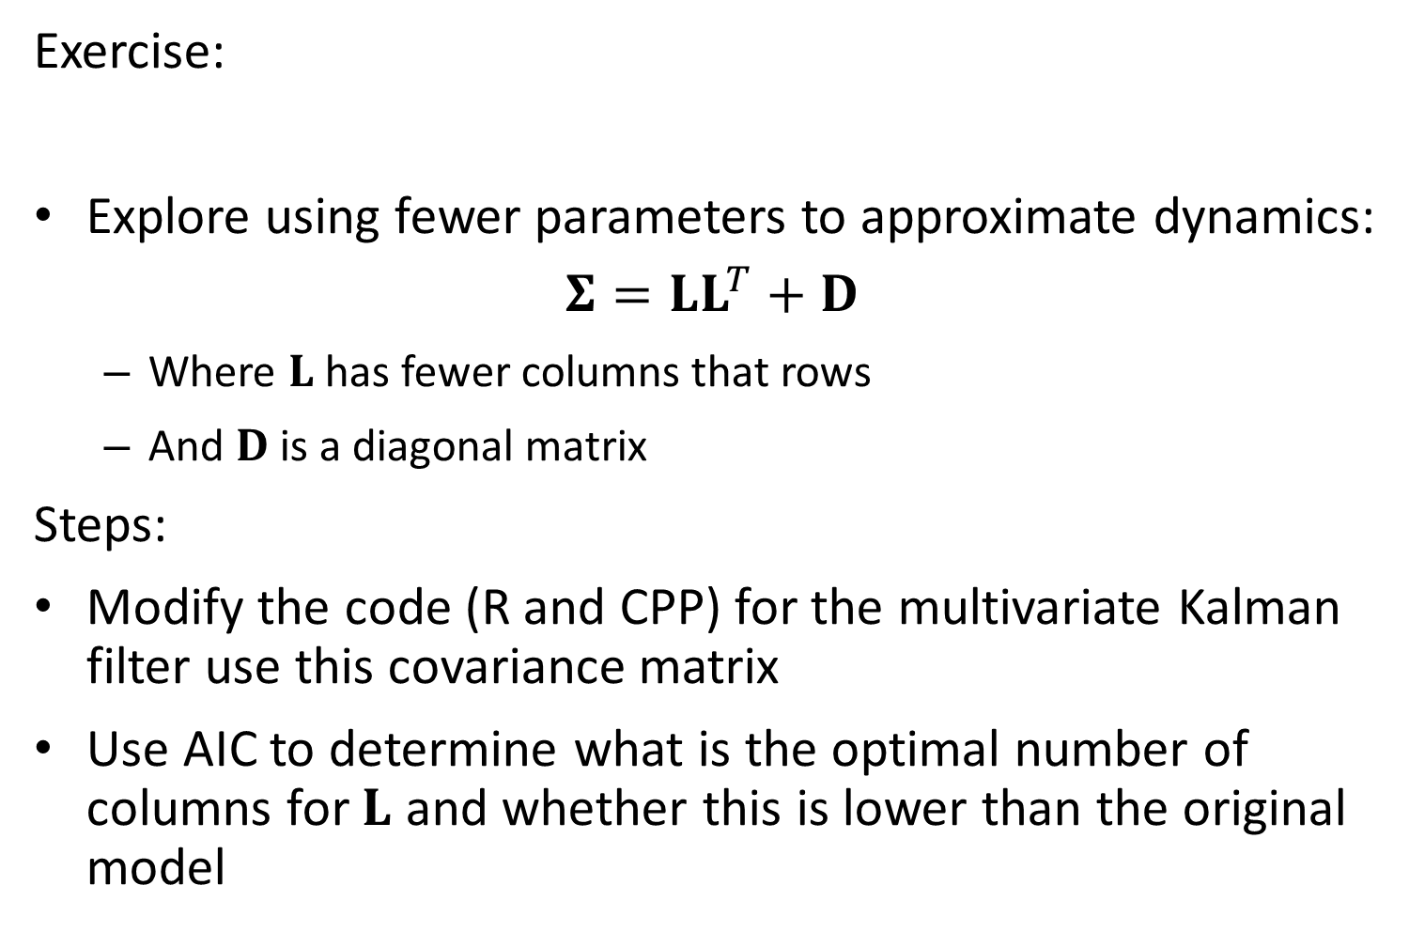
Exercise:
Explore using fewer parameters to approximate dynamics:
$$Σ=LL^{T}+D$$
Where $L$ has fewer columns that rows
And $D$ is a diagonal matrix
Steps:
Modify the code (R and CPP) for the multivariate Kalman filter use this covariance matrix
Use AIC to determine what is the optimal number of columns for $L$ and whether this is lower than the original model

Slide 19
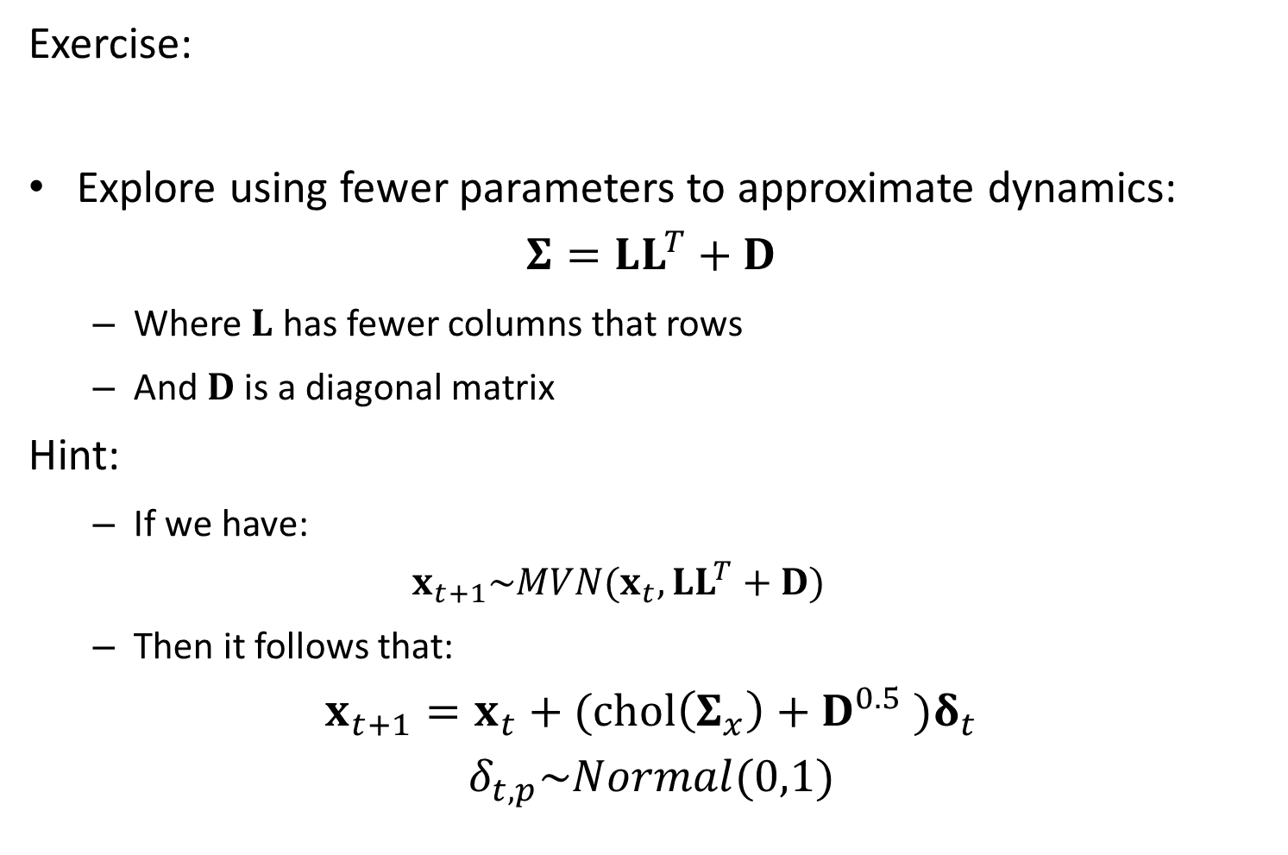
Exercise:
Explore using fewer parameters to approximate dynamics:
$$Σ=LL^{T}+D$$
Where $L$ has fewer columns that rows
And $D$ is a diagonal matrix
Hint:
If we have:
$$x_{t+1}\sim MVN(x_{t},LL^{T}+D)$$
Then it follows that:
$$x_{t+1}=x_{t}+(chol\left(Σ_{x}\right)+D^{0.5} )δ_{t}$$
$$δ_{t,p}\sim Normal(0,1)$$

